Slide 1
Monthly Update on 2018-2019 WRAP Workplan December 4th, 2019 TSC and Work Group Co-Chairs Call
Tribal Data WG
Fire and Smoke WG
Oil and Gas WG
Regional Technical Operations WG
Regional Haze Planning WG

Slide 2
Tribal Data Work Group

Slide 3
Workplan Progress by Tribal Data Work Group
Workplan Progress over the Last 2 Months
Draft of TDWG participation letter; reviewed
Tribal Oil & Gas report – distributed to subject tribes
Planning calls/webinar with ITEP
Workplan Tasks for the Next Two Months
Tribal Oil & Gas report – distribution to OGWG – possibility of comments/edits
Webinar with ITEP- debrief
Send TDWG participation letter – via WRAP staff/WRAP web service
Do a round of updating to tribal contacts list with “active tribes”

Slide 4
Workplan Coordination Activities by Tribal Data Work Group
Workplan Coordination Occurring over the Last Month
Webinar/planning calls (TDWG & ITEP)
Workplan Coordination Needed over the Next Two Months
Any comments from OGWG on EN3’s report (originally asked for 2 week turnaround)
Webinar – debrief (TDWG & ITEP)
Any major updates on contact list to other WGs

Slide 5
Fire and Smoke Work Group

Slide 6
Workplan Progress by Fire and Smoke Work Group
Workplan Progress over the Last Month
Held 2 RBFFS calls and one FSWG call
Reviewed WESTAR-WRAP Modeling Scenarios draft V5 document,
Discussion around this shaped framework for generating future fire scenario
Matt Mavko produced a memo outlining the concept for the future wildfire scenario, which was discussed via email.
Matt generating a future fire scenario based on these discussions
Discussed ideas for the future of FETS, perhaps as a passive repository with fixed data structure. An easier framework to manage that could still add value.
Paul gave status of smoke management programs survey, next steps are figuring out how to port info to web.
Workplan Tasks for the Next Two Months
Continue discussing FETS ideas
Continue looking at web display of smoke management programs survey
Matt Mavko generating Rep Baseline and Future Fire scenario reports.

Slide 7
Workplan Coordination Activities by Fire and Smoke Work Group
Workplan Coordination Occurring over the Last Month
Held 2 RBFFS calls and one FSWG call
Coordinated with RTOWG on planned modeling runs.
Reviewed WESTAR-WRAP Modeling Scenarios draft V5 document
Workplan Coordination Needed over the Next Two Months
?

Slide 8
Oil and Gas Work Group

Slide 9
Workplan Progress by Oil and Gas Work Group
Workplan Progress Over the Last Month
OGWG and Project Management Team (PMT) review and feedback
Tasks 2, 3, 4 – Underway
Workplan Tasks for the Next Two Months
Task 2: Forecast 2028 Inventory (OTB & OTW)
“Reduced Legacy Well Activity” and “Increased Horizontal Well Activity” Scenarios
No additional controls analysis
Task 3: Forecast 2028 Inventory (Additional Reasonable controls)
Methodology by which emission control estimates may be made by regulatory agencies
Task 4: Agency Program Review Task
Emphasis on describing state programs with agency input

Slide 10
Workplan Coordination Activities by OGWG
Workplan Coordination Occurring Over the Last Month
Nov. 12 – Project Management Team Call
OGWG and PMT review and feedback on draft work products
Alternate Scenarios Draft Report/Memo (2 scenarios included) & spreadsheets
Additional Reasonable Controls Report/Memo
Agency Input to describe state programs
Workplan Coordination Needed Over the Next Two Months
Dec. 10 – OGWG Bi-Monthly Call
Dec. 13 – Deadline for OGWG and PMT review and feedback on draft work products
OGWG Agency Program Review Memo and spreadsheet
Dec. 16 – Project Management Team Call
Jan. 21 – Project Management Team Call
Coordination with RHPWG Control Measures Subcommittee
Coordination (External to WRAP) Occurring / Needed
EPA’s 2016 Modeling Platform Collaborative – availability of OGWG baseline & future inventory
2017 NEI – account for inventory improvements

Slide 11
Regional Technical Operations Work Group

Slide 12
Workplan Progress by RTOWG
Workplan Progress over the Last Month
Sensitivity simulations
Fire plume rise
BEIS v. MEGAN biogenic emissions
Treatment of explicit elements
Partial CAMx 2014v2 model performance evaluation
Discussion of products to include in TSSv2

Slide 13
Workplan Progress by RTOWG
Workplan Progress over the Last Month (cont’d)
Emission sectors to update for representative baseline and 2028 On the Books inventories
Source of emissions for the 12-km 12WUS2 domain and the WRAP current Representative Baseline (RepBase) and 2028OTBa emission scenarios.
Source Sector | RepBase | 2028 OTB | 2028 SMOKE Required
California All Sectors 12WUS2 | CARB-2014v2 | CARB-2028 | Yes-UNC (T4.1)
WRAP Fossil EGU w/ CEM | WRAP-RB-EGU | WRAP-2028-EGU¹ | Yes-Ramboll (T4.2)
WRAP Fossil EGU w/o CEM | WRAP-RB-EGU | WRAP-2028-EGU | Yes-Ramboll (T4.2)
WRAP Non-Fossil EGU | EPA-2016v1 | EPA-2028v1 | Yes-Ramboll (T4.2)
Non-WRAP EGU | EPA-2016v1 | EPA-2028v1 | No (EPA Platform)
O&G WRAP O&G States | WRAP-RB-O&G | WRAP-2028-O&G | Yes-UNC (T4.3)
O&G WRAP Other States | EPA-2016v1 | EPA-2028v1 | Yes-UNC (T4.3)
O&G non-WRAP States | EPA-2016v1 | EPA-2028v1 | Yes-UNC (T4.3)
WRAP Non-EGU Point² | WRAP-2014v2 | EPA-2028v1 | Yes-Ramboll
Non-WRAP non-EGU Point | EPA-2016v1 | EPA-2028v1 | Yes-Ramboll
On-Road Mobile 12WUS2 | WRAP-2014v2 | WRAP-2028-Mobile | No (WRAP MS study)
On-Road Mobile 36US | EPA-2016v1⁴ | EPA-2028v1⁴ | No (EPA Platform)
Non-Road 12WUS2 | EPA-2016v1 | WRAP-2028-Mobile | No (WRAP MS study)
Non-Road non-WRAP 36US | EPA-2016v1 | EPA-2028v1 | No
Other (Non-Point) 12WUS2 | EPA-2016v1 | EPA-2028v1 | Yes-UNC (T4.5)
Can/Mex/Offshore 12WUS2 | EPA-2016v1 | EPA-2028v1 | Yes-UNC (T4.6)
Fires (WF, Rx, Ag)³ | WRAP-RB-Fires | WRAP-RB-Fires³ | No (already processed)
Natural (Bio, etc.) | WRAP-2014v2 | WRAP-2014v2 | No (2014v2)
Boundary Conditions (BCs) | WRAP-2014-GEOS⁵ | WRAP-2014-GEOS⁵ | Hold BCs Constant?
WRAP-EB-EGU and WRAP-2028-EGU has updates from WRAP states. WRAP-2014v2 Non-EGU Point has updates from WRAP states A second 2018OTBb run will be made using 2014v2 actual fires

Slide 14
No. | Task | Description | Date
1. | 3.2 | CAMx-ready 2002 36/12-km emissions inputs Emissions summary tables (2002, 2014v2 and RepBase) [IWDW] | Dec 23, 2019 Dec 23, 2019
2. | 3.2 | PPT of 2002 emissions development ASCI gridded 2002 emissions [IWDW] | Dec 31, 2019 Dec 31, 2019
3. | 3.3 | Spatial QA plots of 2002 & RepBase concentrations | Jan 8, 2020
4. | 3.4 | Observed and projected Visibility at CIAs | Jan 16, 2020
5. | 3.4 | PPT on Dynamic Evaluation Spreadsheet of Dynamic Eval. Vis results at CIA [IWDW] Webpage on Dynamic Evaluation with results [IWDW] | Jan 22, 2020 Jan 22, 2020 Jan 24, 2020
6. | 4.1 | Summary tables comparing RepBase and 2028 EGU emissions | Dec 11, 2019
7. | 4.2 | CMAQ-ready 2028 emissions for 36US1 and 12US2 domains | Dec 23, 2019
8. | 4.2 | CAMx-ready 2028 emissions for 36US1 and 12WUS2 domains PPT on 2028 SMOKE modeling | Dec 31, 2019 Jan 3, 2020
9. | 4.3 | ASCII gridded 2028OTBa&b emissions [IWDW] | Jan 9, 2020
10. | 4.4 | Annual/Seasonal spatial maps of 2028OTBa&b key species ASCII gridded 2028OTBa&b ann/seas concentrations [IWDW] | Jan 15, 2020 Jan 15, 2020
11. | 6.1 | PPT on verification of the CAMx 2014v2 & RepBase on IWDW | Dec 19, 2019
12. | 6.2 | PPT on HYSPLIT back trajectories and residence time analysis Gridded ASCII residence time fields for all CIAs [IWDW] | Jan 16, 2020 Jan 16, 2020
13. | 4.6 | Preliminary 2028OTBa&b visibility projections PPT on 2028OTBa&b modeling and visibility projections Spreadsheet with 2028OTBa&b visibility projections [IWDW] | Jan 28, 2020 Jan 30, 2020 Jan 30, 2020
14. |  | PPT on WEP analysis ASCII gridded WEP & emissions and point sources [IWDW] | Feb 6, 2020 Feb 6, 2020
15 | 4.5 | CAMx 2028 WF and Rx fire sens modeling results Annual/Seasonal spatial maps of 2028 fire sens ASCII gridded 2028 fire sens concentrations [IWDW] | Feb 17, 2020 Feb 19, 2020 Feb 19, 2020
16 | 4.6 | PPT on additional visibility projections 2028 projection for IWDW [IWDW] | Feb 20, 2020 Feb 20, 2020
17 | 4.7 | PPT on 2028 state SrcApp modeling 2028 State SrcApp Vis Results at CIAs [IWDW] | Feb 21, 2020 Feb 21, 2020
18 | 6.2 | Final WEP products to IWDW [IWDW] | Feb 21, 2019
A | 5.2 | Monthly Progress Reports and Invoices | Monthly
B | 6.3 | Update RepBase WebPage on IWDW [IWDW] | Dec 18, 2019
C | 6.3 | Dynamic Evaluation WebPage [IWDW] | Jan 29, 2020
D | 6.3 | Update RepBase WebPage with 2028OTB [IWDW] | Feb 5, 2020
E | 6.3 | Update WebPage with Fire Sens [IWDW] | Feb 26, 2020
F | 6.3 | Update WebPage with 2028 SrcApp [IWDW] | Mar 11, 2020
G | 6.3 | Update WebPage [IWDW] | Mar 30, 2020
Workplan Progress by RTOWG
Workplan Tasks for the Next Two Months through March 2020

Slide 15
Workplan Coordination Activities by RTOWG
Workplan Coordination Occurring over the Last Month
Coordination with Ramboll on modeling progress (11/12)
Monthly RTOWG call (11/19)
Review sensitivity simulations
Partial performance evaluation of CAMx 2014v2
Discussion on modeling products and updates on schedule
Bi-weekly RTOWG co-chair coordination calls
Participation in other workgroup calls

Slide 16
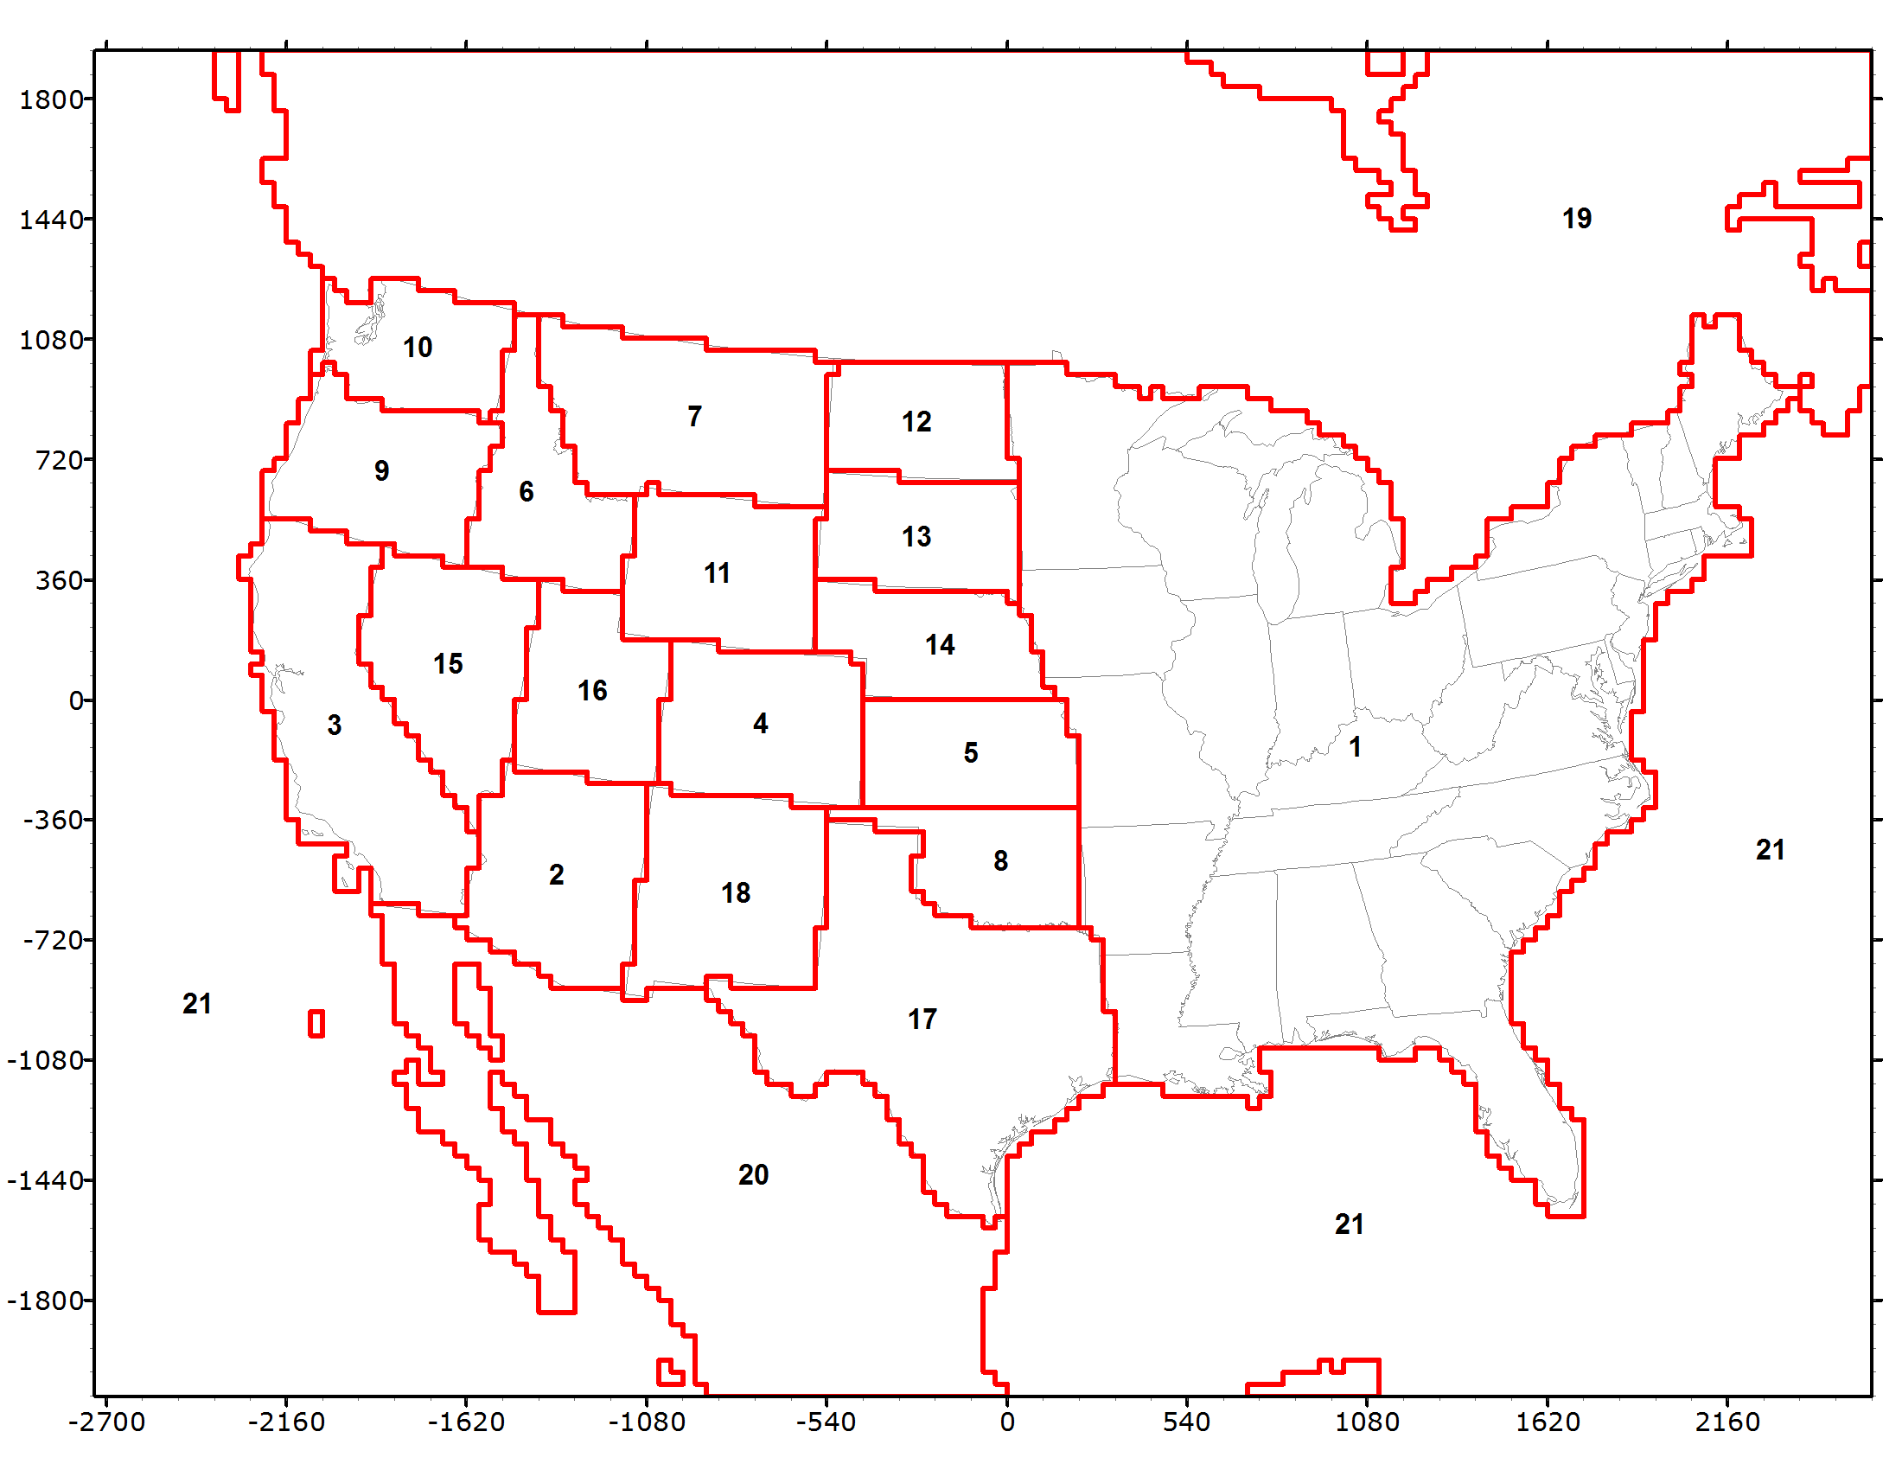
Workplan Coordination Activities by RTOWG
Workplan Coordination Needed over the Next Two Months
RTOWG call (12/10)
CAMx 2014v2 MPE
2014v2 v. baseline emission inventory
Coordination calls with Ramboll for completion of Phase III modeling deliverables and preparing for Phase IV
Participation in other workgroup calls
Example: CAMx 2028OTB PM Source Apportionment
2028 Vis Impairment at CIAs by State and Sector
Contributions of International Anthro emissions

Slide 17
Regional Haze Planning Work Group

Slide 18
Workplan Progress & Coordination by Regional Haze Planning Work Group
Workplan Progress and Coordination over the Last Month
Review of EPA’s Regional Haze Guidance
Workplan tasks and Coordination for the Next Two Months
Regional Haze in the West Storyboard feedback/survey
Coordinate ongoing discussions of controls and modeling – both require states to consult with sources

Slide 19
Workplan Progress by Control Measures Subcommittee
Workplan Progress over the Last Month
Call was held on November 25th
States in various stages of 4-factor analysis work
Workplan Tasks for the Next Two Months
Next call in January–
States to update BART/RP controls and costs from Round 1 WRAP RH SIPs
States to provide Q/d thresholds and sources subject to 4-factor work
Continue discussion on determining remaining useful life for EGUs considering retirement

Slide 20
Workplan Coordination Activities by Control Measures Subcommittee
Workplan Coordination Occurring over the Last Month
Participate on monthly O&G Workgroup calls
Workplan Coordination Needed over the Next Two Months
Continue to coordinate with O&G work group and Emission Inventory Subcommittee on emission forecasts.

Slide 21
Workplan Progress by Coordination and Glide Path Subcommittee
Workplan Progress over the Last Month
Elevated TSS FAQ Document to RHPWG
Reviewed TSS Glossary for missing terms
Reviewed of Emissions and Modeling Scenarios Comparison Specs
TSSv2 Delivery Update Presentation
IMPROVE Steering Committee Input
Workplan Tasks for the Next Two Month
Continue overview of TSSv2 development
Gain consensus on TSS FAQ and Glossary
Revisit TSS Priorities document
Support creation of RH Storyboard

Slide 22
Workplan Coordination Activities by Coordination and Glide Path Subcommittee
Workplan Coordination Occurring over the Last Month
The subcommittee coordinated with the following entities:
RHPWG – Elevated TSS FAQ Doc for Consensus
Workplan Coordination Needed over the Next Two Months
RTOWG – Coordination on Natural Conditions Project findings and opportunities to model outcomes for future planning periods.
RTOWG – TSS Priorities for Modeling/EI

Slide 23
Workplan Progress by EI&MP Subcommittee
Workplan Progress over the Last Month
Obtained 2028 OTW/OTB emissions updates from states/locals
California working with contractor to fix Road Dust precip controls in Rep Baseline.
Workplan Tasks for the Next Two Months
Collect Controls Scenario (2028) emissions updates from states/locals
Deliver future facility emissions from states/locals to contractor.
2028 OTW/OTB and Controls scenarios
Contractor to start Rep. Baseline and OTW/OTB simulations

Slide 24
Workplan Coordination Activities by EI&MP Subcommittee
Workplan Coordination Occurring over the Last Month
Coordinated with contractor to update emissions
Workplan Coordination Needed over the Next Two Months
Representative baseline and future modeling scenarios require coordination as needed with O&G WG, contractor, Fire & Smoke WG,
Coordinate with C&GP subcommittee to provide guidance to states on what is needed from them for the different modeling scenarios

Slide 25
End of Workplan Progress Update

